Slide 1
Spotify Top 50 Songs Analysis
Power BI College Project

Slide 2
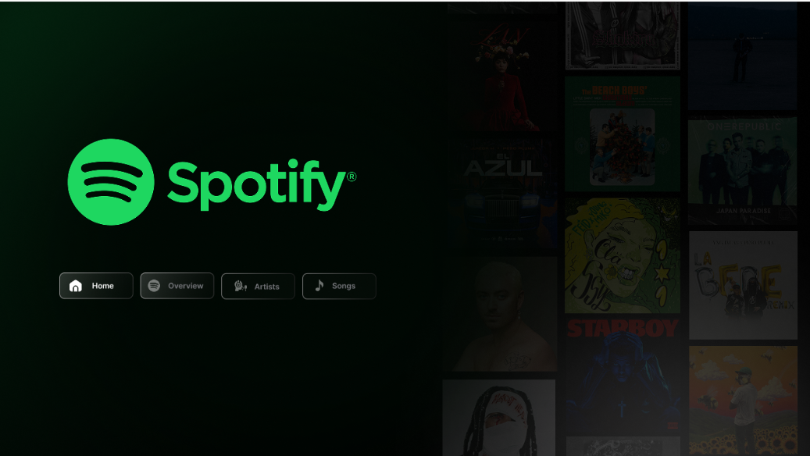
Home Dashboard
Explanation
Professional landing page with Spotify
branding.
Navigation buttons for all report pages.
Dark theme improves readability.
Album artwork creates an engaging interface.

Slide 3
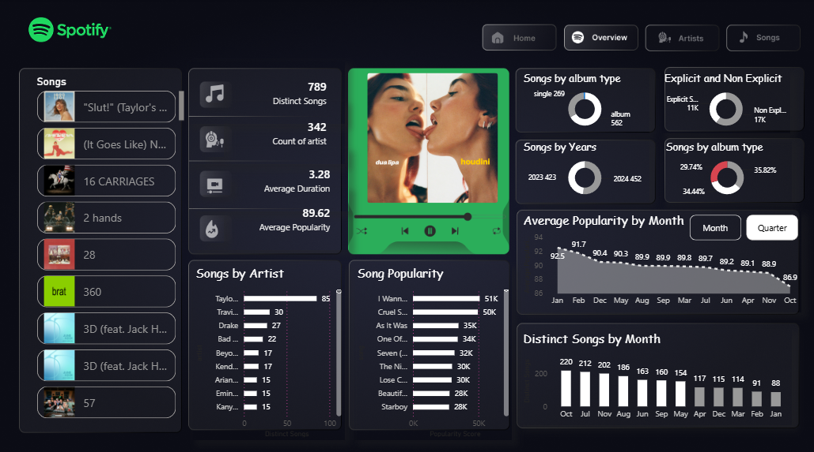
Overview Dashboard
Explanation
KPIs summarize the dataset instantly.
Charts compare artists, popularity and album types.
Trend visuals reveal monthly popularity.
Interactive slicers enable dynamic filtering.

Slide 4
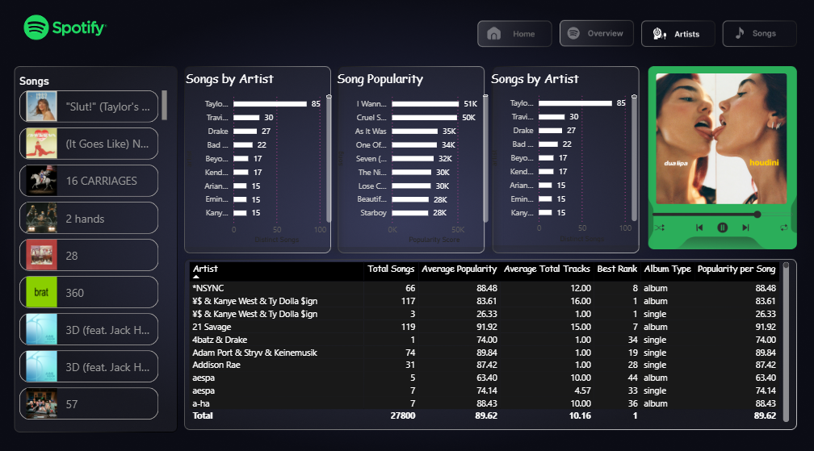
Artists Dashboard
Explanation
Artist ranking compares total songs and popularity.
Detailed table summarizes artist performance.
Useful for identifying top-performing artists.
Dashboard supports drill-down analysis.

Slide 5
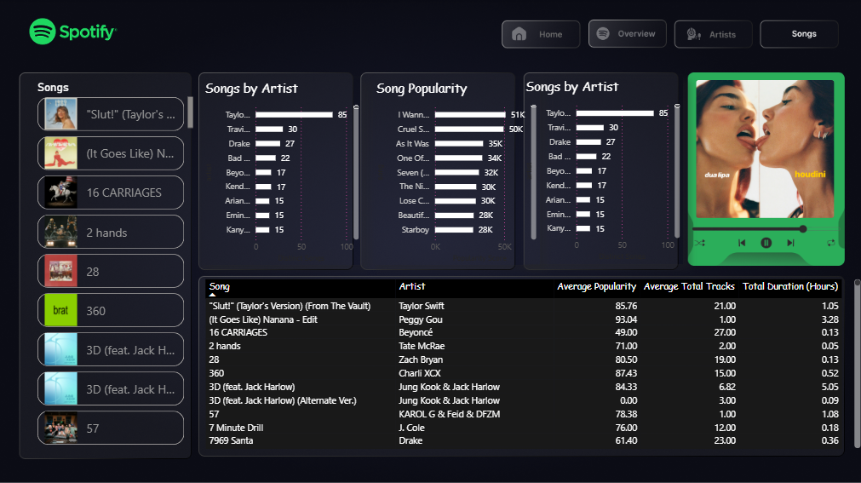
Songs Dashboard
Explanation
Song-wise table displays popularity and duration.
Top songs are highlighted using bar charts.
Users can compare songs interactively.
Supports detailed music analysis.

Slide 6
Key Insights
• Average popularity is approximately 89.6, showing that the dataset contains highly successful songs.
• Taylor Swift has the highest number of songs among featured artists.
• Album releases slightly exceed singles in the dataset.
• Most popular tracks are between 3 and 4 minutes in duration.
• Interactive visuals make comparison of artists and songs quick and effective.

Slide 7
Conclusion
• Power BI transformed raw Spotify data into meaningful insights.
• The dashboard helps identify trends in popularity, artists and songs.
• Interactive filtering improves user exploration and decision making.
• The project demonstrates the value of business intelligence in music analytics.

